Slide 1
Data is the new oil, oil data is the new oil oil
Zsófia Farsang, András Kárpáti
Machine Learning final presentation

Slide 2
Agenda
Research question
Hypothesis
Methodology
Results

Slide 3
Research question
Oil is a central commodity to the global economy
Influenced by many factors – Influences many factors
Subject to non-market type shocks
Eg.: OPEC decisions, wars, natural disasters
Poses tremendous risk to oil companies – trading in oil based derivatives is extensive
Motivation: Brynjolfsson predicting house prices
Can we predict oil price volatiliy on the short run?

Slide 4
Hypothesis
Machine learning methods are more effective than traditional linear models
Google Trends data is a good predictor
Combining a neural network and an ARCH model significantly improves the effectiveness of the forecast

Slide 5
Title and Content Layout with Chart

Slide 6
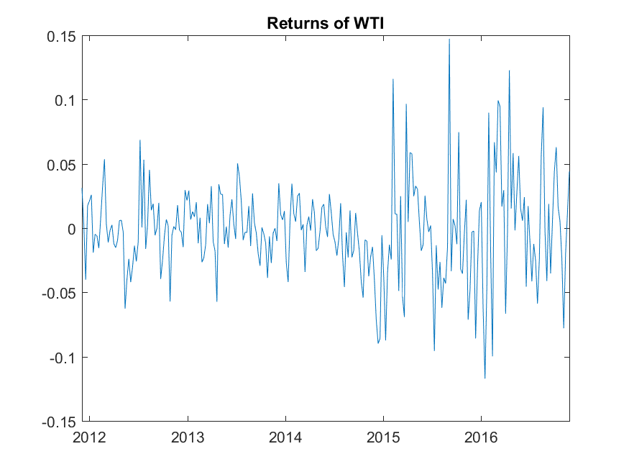

Slide 7
Methodology
 | Datapoints | Percentage
Total | 262 | 100
Train | 183 | 70
Validation | 39 | 15
Test | 40 | 15
Data
WTI crude weekly data incl. futures
USD / Rupee Exchange rate
US Treasury bill rate
Gold price
Google search keywords OPEC, Russia, crude oil etc
Models
ARCH (1)
ARCH (2)
Neural network 5-fold CV, backpropagation
Ensemble
Volatility is understood as standard deviation of returns
ARCH uses the last 4 observations to predict the next 4
Model selection criteria is RMSE

Slide 8
So…. What the hell came out of Matlab? II
Notes:
Much better fit, could learn the points well

Slide 9
So…. What the hell came out of Matlab? I

Slide 10
So…. What the hell came out of Matlab? III

Slide 11
Comparing the models

Slide 12
Quantifying results
 | With Trends Data | Only financial Data
Train | 0,01312 | 0,01232
Validation | 0,01051 | 0,00992
Test | 0,01394 | 0,01500
RMSEGARCH(0,1) | 0,01921 | 0,01921
RMSEGARCH(0,2) | 0,01903 | 0,01903
GARCH+NN Validation | 0,01710 | 0,01710
GARCH+NN Test | 0,01882 | 0,01962
Prediction is good compared to overall variance
It is not evident that Trends data is significant
Ensemble was an unfruitful venture
However, the main hypothesis that machine learning methods are more effective that traditional is confirmed
 | Average | StDev
Original Series | 0.028603 | 0.018703
Notes:
We predicted 25% of the original variance

Slide 13
Further research
We listed 7 things. Most importantly:
Economic viability
Trend filtering
SVM for ensemble
Diebold-Mariano test
Question of frequency and usage of Trends data

Slide 14


Slide 15


Slide 16


Slide 17


Slide 18


